Slide 2
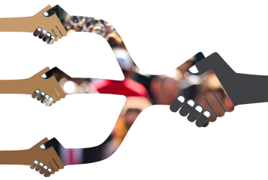
Partnership is . . .
The 'selfless furtherance of a common goal'
A counter-intuitive act
A leadership choice: not for believers in the 'power of one'
A broader support base for change & complexity
Sharing the burden, but not the reward
Uvukula Foundation

Slide 3
Leading in partnership; King Moshoeshoe
A selfless democrat who governed in partnership
He practised counter-intuitive daring
Always served the collective interest, not himself
Style: ‘our selfless furtherance of our common goal'
The inherent grace to transform enemy into partner
The King understood inclusive governance
Uvukula Foundation

Slide 4
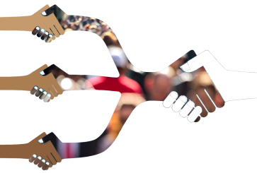
Lessons from Moshoeshoe
He understood the economy comes first
Protect your people and not only yourself
Found visionary traction with contra conventional daring
Managed resources with balanced inclusivity
Selflessly furthered a national common goal
Had predictably principled leadership conduct
Leading in & through partnership
Uvukula Foundation

Slide 5
Mertech Group: discovering a ‘Partner’
1980: desperation, 30%, turnaround, testimony
Now 200 co’s, Africa & EU - Property, Technology(3), Hydro power, Coal mining,
Short term insurance, Luxury goods, Health & Marine cable recovery
Foundation now 70%; provides R100m+ p.a. for community work
Creator as snr 'Partner' & controlling Shareholder
The ultimate for 'Unleashing the Power of Partnerships'
Uvukula Foundation

Slide 6
Mertech Partner Lessons (36 yrs)
Sharing easier with uncompromised quality
Sharing: ability vs ‘control obsession’
Pragmatic acceptance – 50/50 not 60/40
Broader: stakeholders, Windhoek project; duplicate!
The ultimate lesson: WAIT on . . .
Feed the stream of life, not your own dam
The more you give . . .
Uvukula Foundation

Slide 7
Steps to significance
Self-interest only
Or always put employer before own interest
Significance: serve outside needs
SIGNIFICANCE: become an instrument in His hand
Significance: unexpected fulfilment
Success
Significance
1
2
3
Uvukula Foundation

Slide 8
Ad Ubi?
Inform yourself & consider partnering
Commit or 'take a bite'
Explore significance beyond . . .
The ‘power of one’ & discover . . .
The partnership power of one plus one + . . . & even . . .
The power of the One
Uvukula Foundation

