Slide 1
North-West University Strategy Revision & Annual Performance Plan for 2021
Presentation to Council by Prof Dan Kgwadi
Principal & Vice-Chancellor
19 November 2020

Slide 2
The Year in Retrospect
Due to COVID-19, 2020 has been a trying year for NWU as it has for many institutions across the globe
Primary objective was to ensure that we completed the academic year
Continued our teaching and learning activities in the online mode
Gradually re-introduced staff and students to our campuses as lockdown alert levels relaxed
Successfully completed the first semester teaching and learning programme and on track to complete a successful year

Slide 3
Staff: Virtual Teaching and Learning Conference
More than 200 registered delegates
Pre-conference workshop
Student panel discussions - offered delegates the opportunity to engage directly with students on relevant conversation points about teaching and learning which included content, assessment, language, inclusion, and disciplinary identity

Slide 4
Students: Graphic Design student from NWU wins award
The design of a final year student was chosen as one of three to grace the Nescafé Ricoffy tins.
South Africans were given the opportunity to design a “Proudly me” Nescafé Ricoffy limited edition label. All the designs were inspired by pride and had to showcase what it means to be “Proudly Me”.
More than 312 entries were received from across the country.

Slide 5
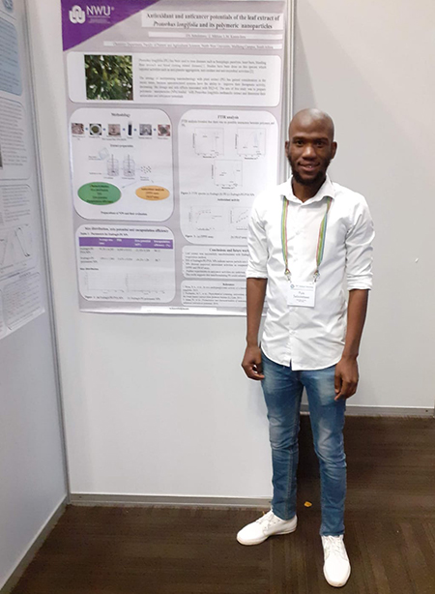
Students: Medicinal plant extracts with nanotechnology
A NWU graduate is bringing together age-old plant knowledge and the latest nanotechnology to make the most of medicinal plant extracts.
According to a United States National Nanotechnology Initiative, nanotechnology is currently revolutionising the technology and industrial sectors.
MSc graduate Pule Silent Seboletswe conducted research into how nanotechnology can help in finding solutions for problems related to the use of natural products for therapeutic purposes.
During his MSc studies, Pule attended a training course on CAMAG Thin layer/Planar Chromatography in Muttenz, Switzerland and presented papers at two conferences in SA and one in Thailand.

Slide 6
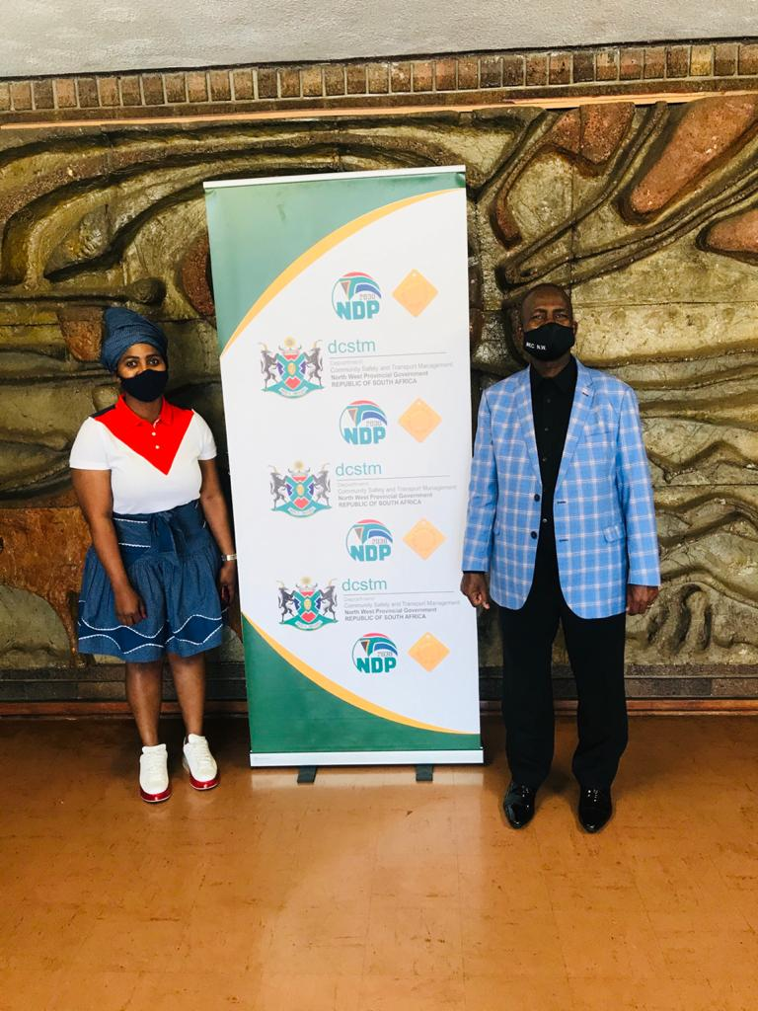
CE: NWU empowers taxi-industry stakeholders
NWU played a significant role in the run-up to the national taxi lekgotla through academic assistance and inputs during the recent district and provincial lekgotlas.
This comes after the North West provincial Department of Community Safety and Transport Management approached the university’s Department of Transport Economics and Logistics Management to make presentations during the lekgotlas held in September and October.
In one of his weekly open letters to the public, President Cyril Ramaphosa emphasised the importance of the national lekgotla, which seeks to find common ground on existing business models, safety and compliance, broader economic empowerment of operators and the issue of subsidies for taxis

Slide 7
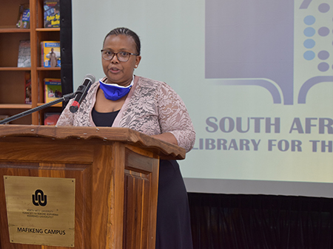
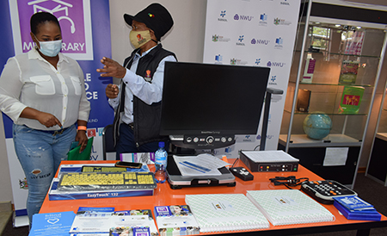
CE: NWU helps with library services for the blind in NW province
NWU has partnered with the North West Department of Arts, Culture, Sport and Recreation (ACSR), and the South African Library for the Blind (SALB) to improve reading access for the blind and the visually impaired in the province.
Project Sponsor: Sasol Social and Community Trust
Aim: to support and enhance the existing services for the visually impaired, and will benefit 24 established mini community libraries for the blind in North-West municipalities.

Slide 8
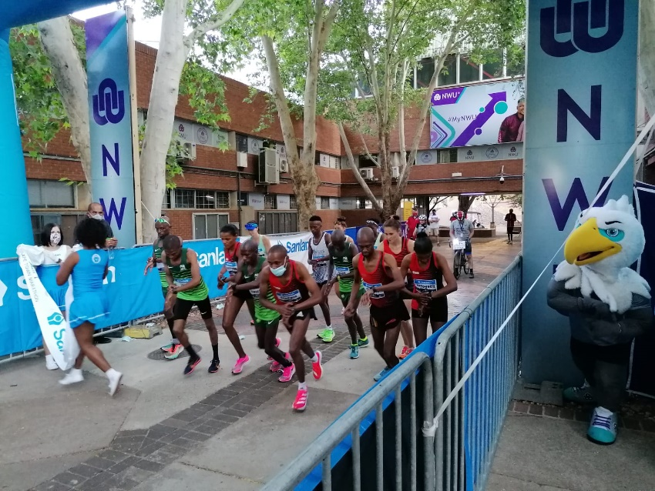
Sport: A different guise, a great event
It was an event as unique as it was entertaining. It was peculiar and inventive. It was a blast. On Sunday, 18 October 2020, the North-West University’s Potchefstroom Campus hosted one of three simultaneous legs of the Sanlam Cape Town Virtual Marathon – Elite Invitational, with the men’s overall winner, Edward Mothibi, running on the Potchefstroom Campus.

Slide 9
Recognition by peers
SA Publication Forum annual ceremony: 11 Nov 2020
Best Covid-19 intervention:
NWU Covid-19 webpage - 2nd runner-up
Best Annual Report:
NWU 2018 Integrated Report (We empower people to soar) - First place
Best electronic newspaper:
NWU internal newsletter - Eish! - First place
Best digital magazine:
NWU alumni magazine - NWU&U - 1st runner-up
Best communication innovation:
NWU live event calendar on the web - 2nd runner-up
Best publication with smaller budget:
NWU&U - 1st runner-up
Eish! - 2nd runner-up

Slide 10
Multimedia campaign: performance
 | Sept | October | Increase
Total impressions | 1 947 491 | 3 851 437 | 1 903 946
Radio interviews | 4 | 4 | N/A
Articles | 3
Owned media reach | 97 700 | 205 390 | 108 390

Slide 11
Imperatives for Change
Imperatives for change
The 4th Industrial Revolution has become a fundamental driver for change, presenting excellent opportunities but also significant threats
The funding of higher education in South Africa is under increasing pressure due to current economic conditions, made worse by Covid-19
The Senior Management Committee met during September to: -
Revise the Common Strategy Assumptions – those elements of our internal and external environment that affect the responsiveness of our strategy
Revise the Success Model – our idealized view of what a successful NWU will look like in future to internal and external stakeholders and financially
Revise the NWU Goals and Enablers (the core elements of our strategy are retained as approved by Council in November 2015)

Slide 12
Our Revised Goals
1: Promote excellent learning and teaching and reposition the NWU to attain the size and shape required by the market direction decisions (NO CHANGE)
2: Strengthen research and innovation with a strategic focus on impactful globalisation
3: Integrate and align community engagement with teaching-learning and research to develop a culture of active citizenship
4: Develop a clearly differentiated student value proposition with a focus on creating an inclusive environment aimed at developing students holistically through structured and unstructured co-curricular programmes which are relevant, desirable and meet students’ needs.
5: Attract, develop and retain excellent staff and create an equitable staff profile
6: The development and implementation of a digital business strategy to create a competitive advantage for the university and ultimately unlock alternative revenue streams. (A NEW GOAL)

Slide 13
Our Revised Enablers
Enabler 1: Govern, lead and manage in an agile, collaborative and integrated way towards an optimally digitised university environment
Enabler 2: Establish a holistic and integrated university technology platform to provide a solid foundation for a digital future
Enabler 3: Cultivate and deliver stakeholder-focused platforms to create and grow intentional experiences and brand equity.
Enabler 4: Ensure financial sustainability and optimal performance with due consideration of macro-economic conditions and a drive towards digital transformation

Slide 14
Annual Performance Plan 2021
On the basis of the revised goals and enablers, the University Management Committee has drafted an Annual Performance Plan for 2021, which is presented to Council for approval

Slide 15
Thank you

